Slide 1
Property Values vs
Quality Of Life?
Do higher housing prices reflect a safer/quieter neighborhood?
A look into the last decade of San Francisco’s population growth

Slide 2
Are housing prices affected by adverse quality of life issues?
Are there significant differences among different neighborhoods?
Have issues affecting different neighborhoods changed over the years?

Slide 3
General Insights
As of 2018, San Francisco had an estimated population of 883,000 people. Since the last US Census in 2010, the City has experienced over 10% in population growth. How has this population affected different neighborhoods? Our analysis was limited to four different metrics: Housing Prices, Policy Activity, Fire Activity and General Citizens Complaints (311).
Houses prices have increased in all neighborhoods.
Police activity has remain fairly steady
311 complaints have increased dramatically
Fire activity has increased significantly (due to a large increase in medical calls)

Slide 4
What is a neighborhood?
In DataSF, there are multiple definitions of neighborhoods:
Analysis Neighborhoods (41)
Realtor Neighborhoods (89)
Planning Neighborhoods (38)
Supervisor Districts (11)
In order to get a more significant set of data per neighborhood, we selected the Supervisor Districts for our analysis. Because these Districts are supposed to include the same number of citizens, it provides the best way to compare trends between neighborhoods.

Slide 5
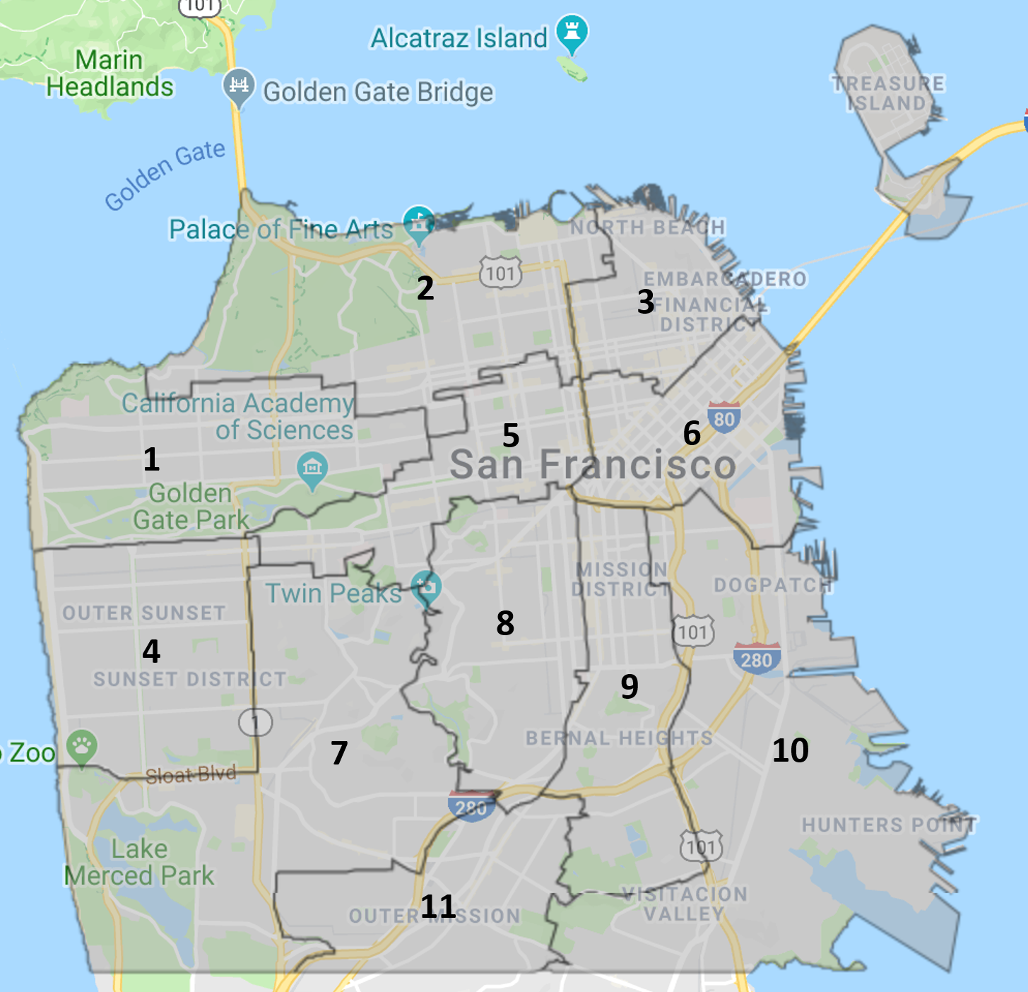
San Francisco Supervisor Districts
(Based on 2000 Census)

Slide 6

To gather this data, big thanks to the City of San Francisco for their impressive Data SF portal and datasets

Slide 7
In DataSF, we found datasets for:
Property Tax Rolls from 2006-2017
SFPD Calls For Service since 2008
Citizen Complaints (311)
SFFD Calls For Service since 2006

Slide 8
Challenges
It is wonderful that so much data is available online. However, we spent a significant amount of time not just analyzing the data but cleaning the data!
The Tax Collector data included many records with null values for critical fields (like Last Date Sale or Construction Year). Also, some data was clearly inconsistent and could not be used.
All data sets included fields with mixed type values (i.e. integers or dates mixed with plain text data)
Looking at 10 years of multiple data sets required spending a lot of time downloading data and processing the data.

Slide 9
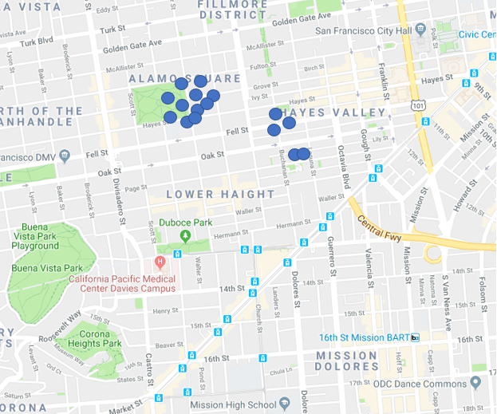
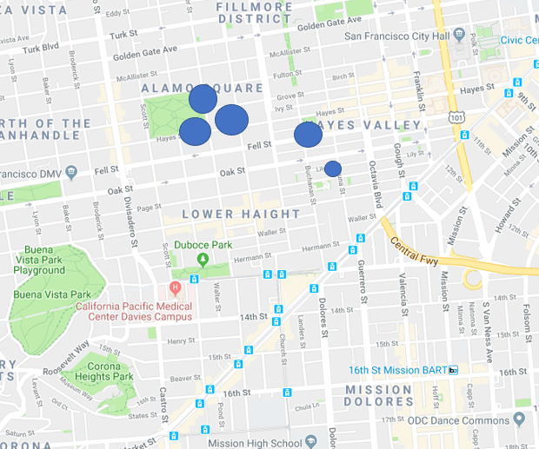
Heat Maps - Weighted Locations
We grouped all incidents into bins where the Latitude/Longitude coordinates were rounded to 3 decimals. It allowed the creation of heat maps using ~1,000 points instead of 100,000 points.

Slide 10
Property Values By District
Because of CA Proposition 13, property values are only re-assessed after the property has been sold. So, we can only evaluate increased in property values on properties that were sold in a given year.
The Date of Sale value had inaccurate data. Surprisingly, not only records with sale prices before 2000 were unreliable (Year 2K Problem), but records sold before 2010 had also problems.
In order to determine properties sold in a particular year, we compared the tax value of the same parcel for two consecutive years. Those with an increase in value greater than 3% were clearly new sales.
In order to provide a consistent way to compared properties, study only includes Dwellings, Condominiums and Live/Work Condominiums. This group includes over 70% of property sales.

Slide 11
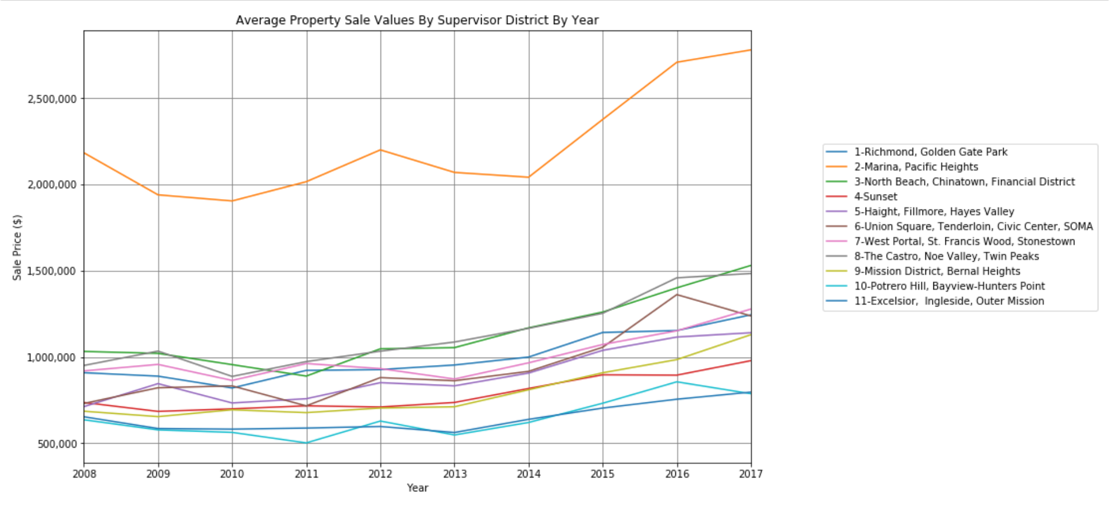
Property Value Trends By District

Slide 12
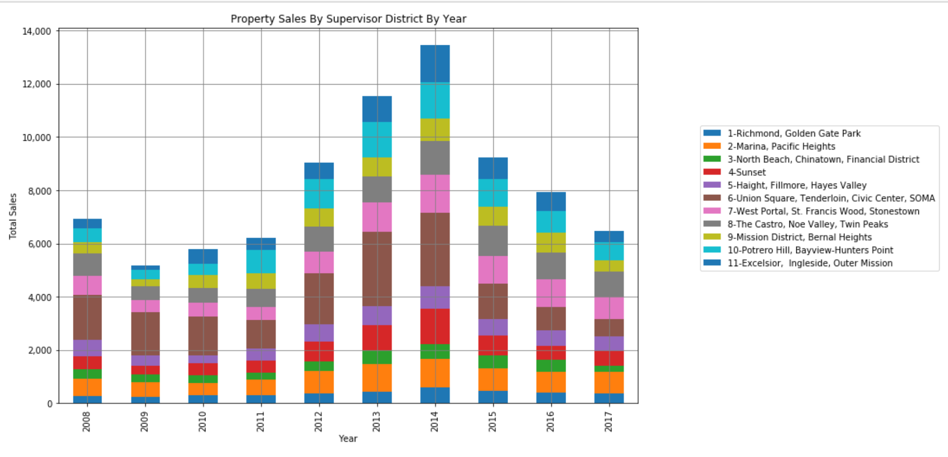
Property Sales By Year

Slide 13
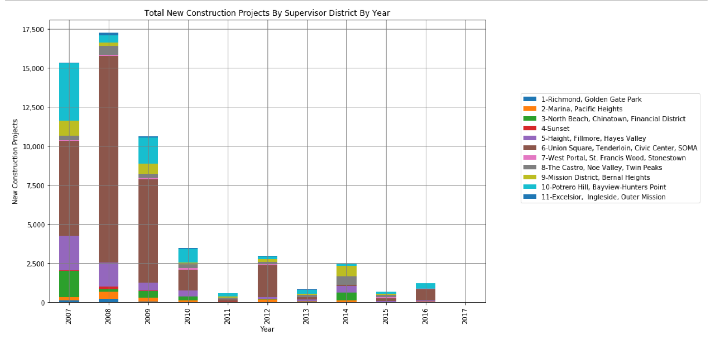
New Construction Projects By Year

Slide 14
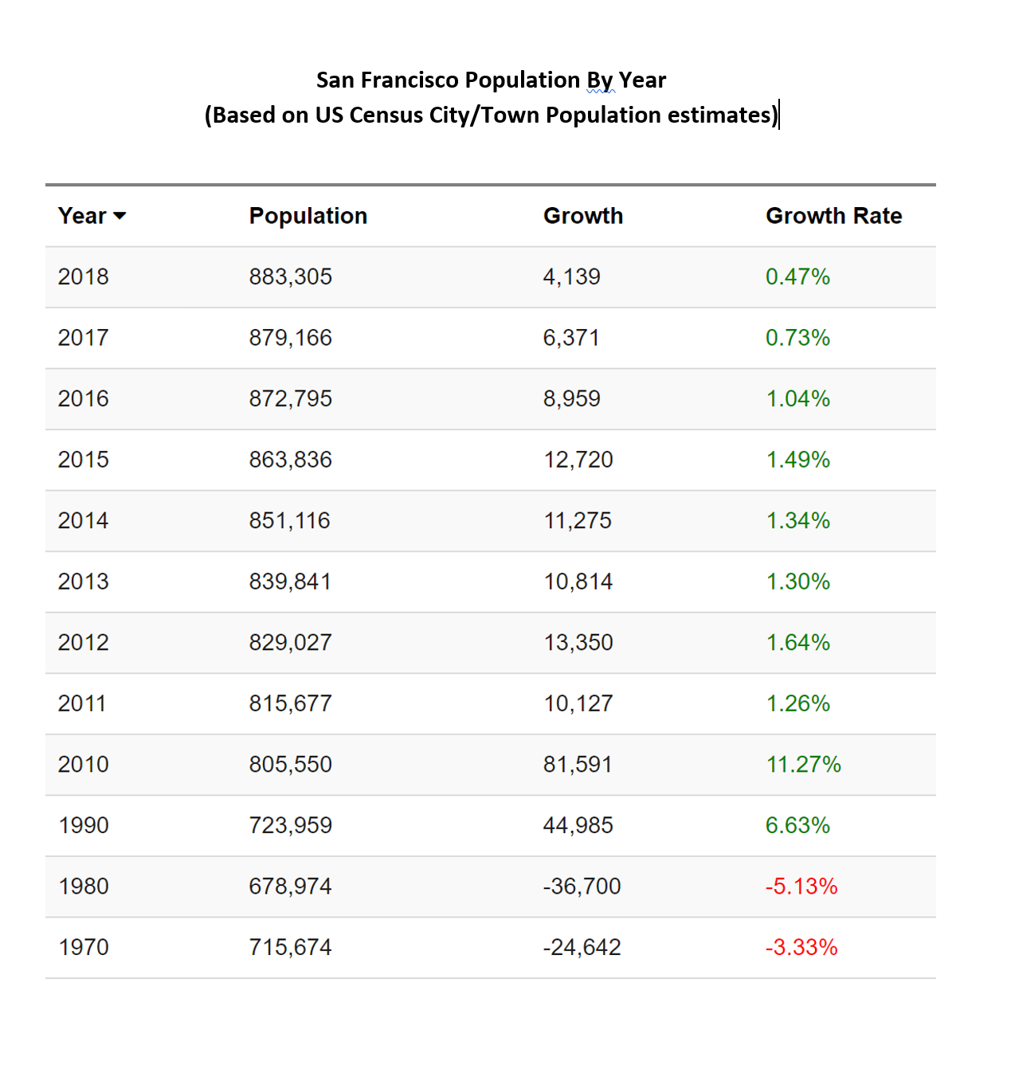
Are the new construction numbers for 2007-2008 possible?
Based on historic population numbers, San Francisco had a large increase in population during the 2000-2010 period

Slide 15
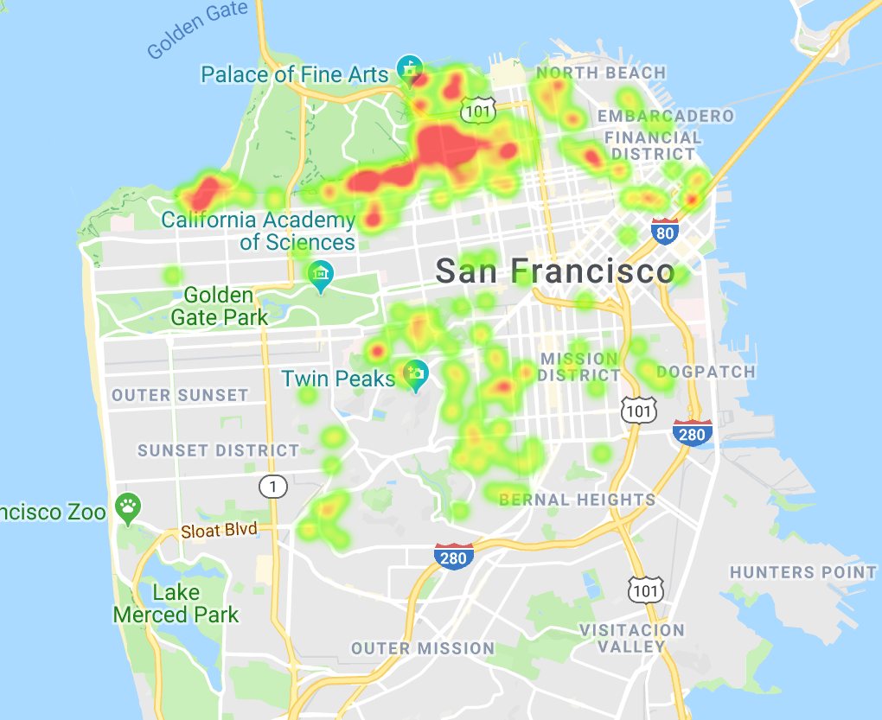
Heat Map: Location of High Value Properties ($3M or higher)

Slide 16
Observations Based on Property Sales Data
District 2 (Marina/Presidio/Sea Cliff) has, by far, the highest average property prices of all Districts. Overall property values in this District are about 2.12 times more expensive than the average property in the City.
Districts 5, 6, 9 (SOMA, Mission, and Hayes Valley) experienced the greatest increase in average property values for the period considered. District 6 also had the greatest number of property sales in the years 2012-2015.
Districts 10 and 11 (Bayview, Ingleside, Outer Mission) have the lowest overall prices and experienced the lowest increase in property values. Properties in these districts are about 0.60 times less expensive than the average property in the City.

Slide 17
Police Department Calls By District
Police activity has been fairly steady for the last decade.
District 4 (Sunset) had the highest increased in Police Activity (50%). However, Police activity in this District is very low.
The second increased in Police Activity was in District 6 (SOMA) with 27%.
District 1 (Richmond) had a decrease in Police Activity (11%)
Overall District 10 has the highest rate of Police Activity (Bayview/Hunters Point)
Overall, District 7 (West Portal/Stonestown) has the lower rate of Police activity

Slide 18
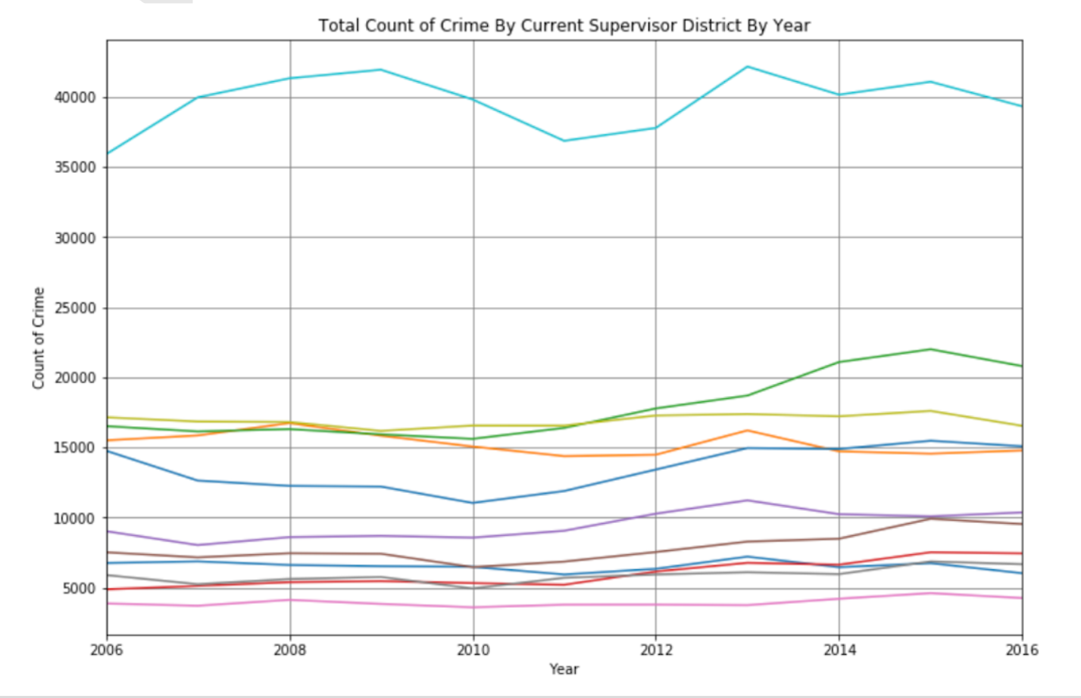
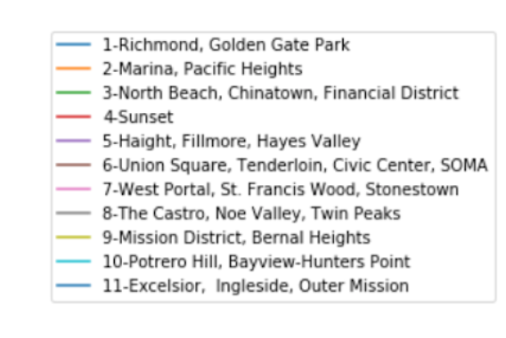
Police Department Calls By Year/District

Slide 19
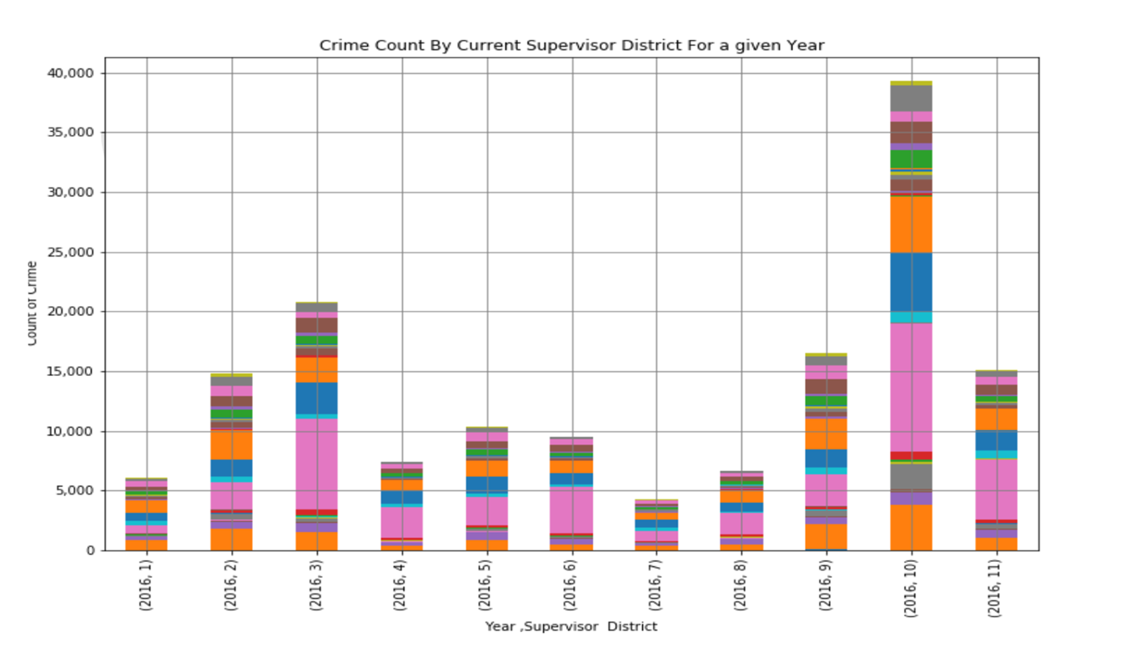
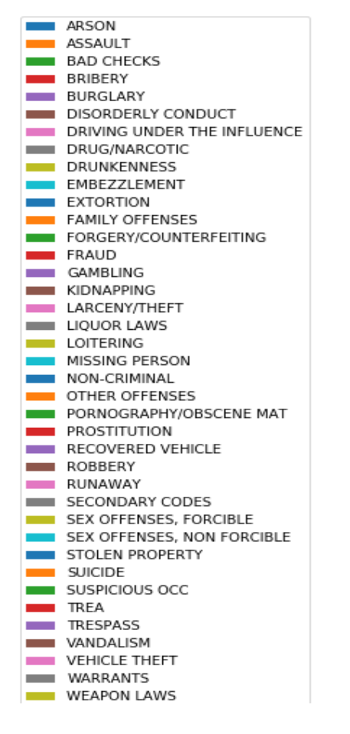
Police Calls By Type (Year 2016)

Slide 20
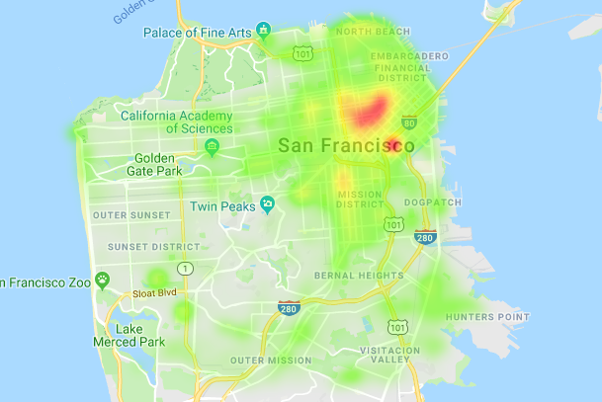
Heat Map: Location of Police Calls

Slide 21
Citizen Complaints (311 Calls) By District
We analyzed the 311 Call Data by District and Year
We also looked at the different Complaints Type by Year.
Converting Date/Time data to Year in order to better group the results was very challenging.
The number of complaints per year increased significantly in the 2006-2016 period.

Slide 22
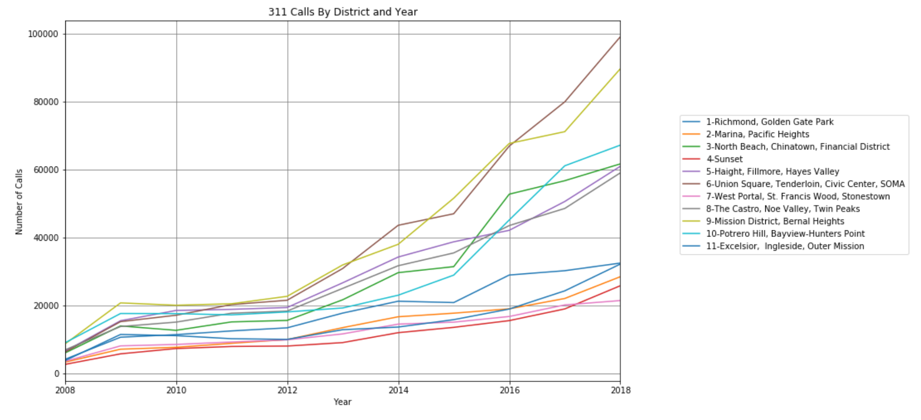
Citizen Complaints (311 Calls) By District

Slide 23
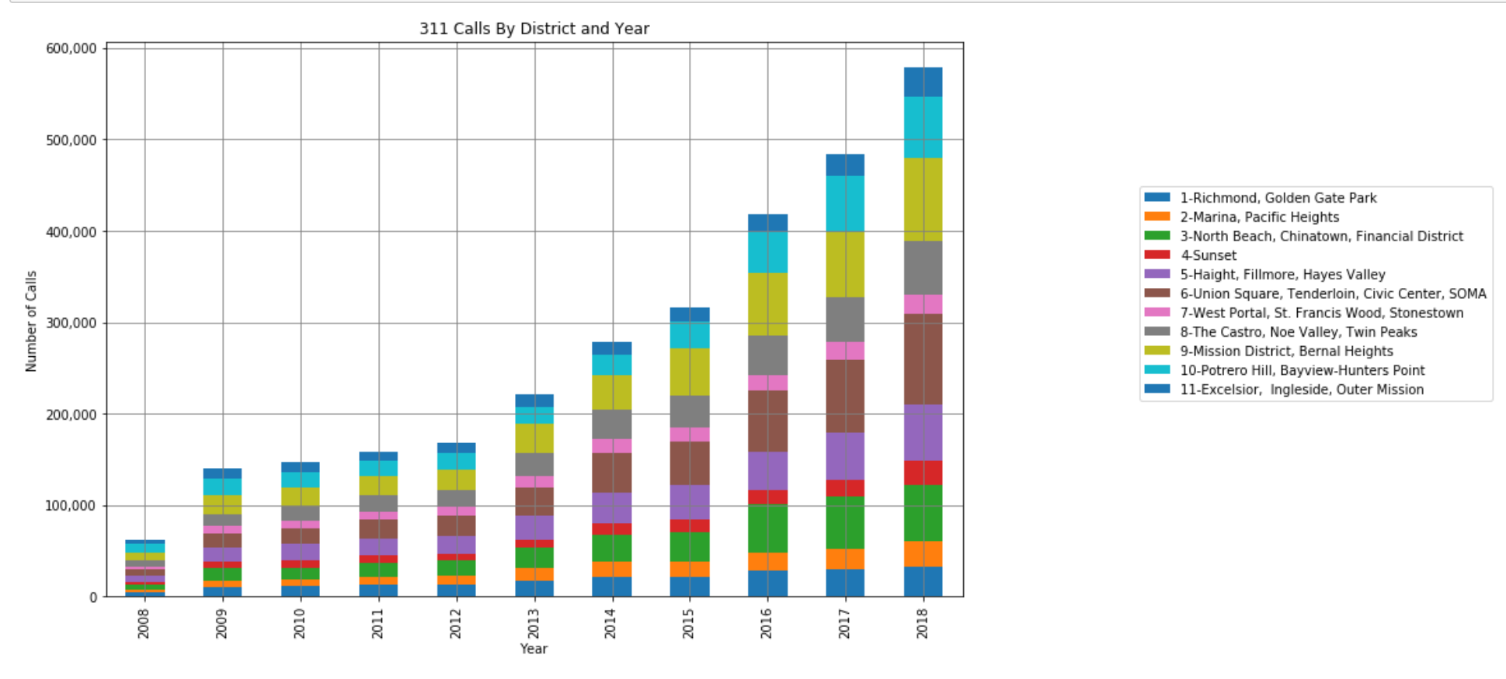
Citizen Complaints (311 Calls) By District

Slide 24
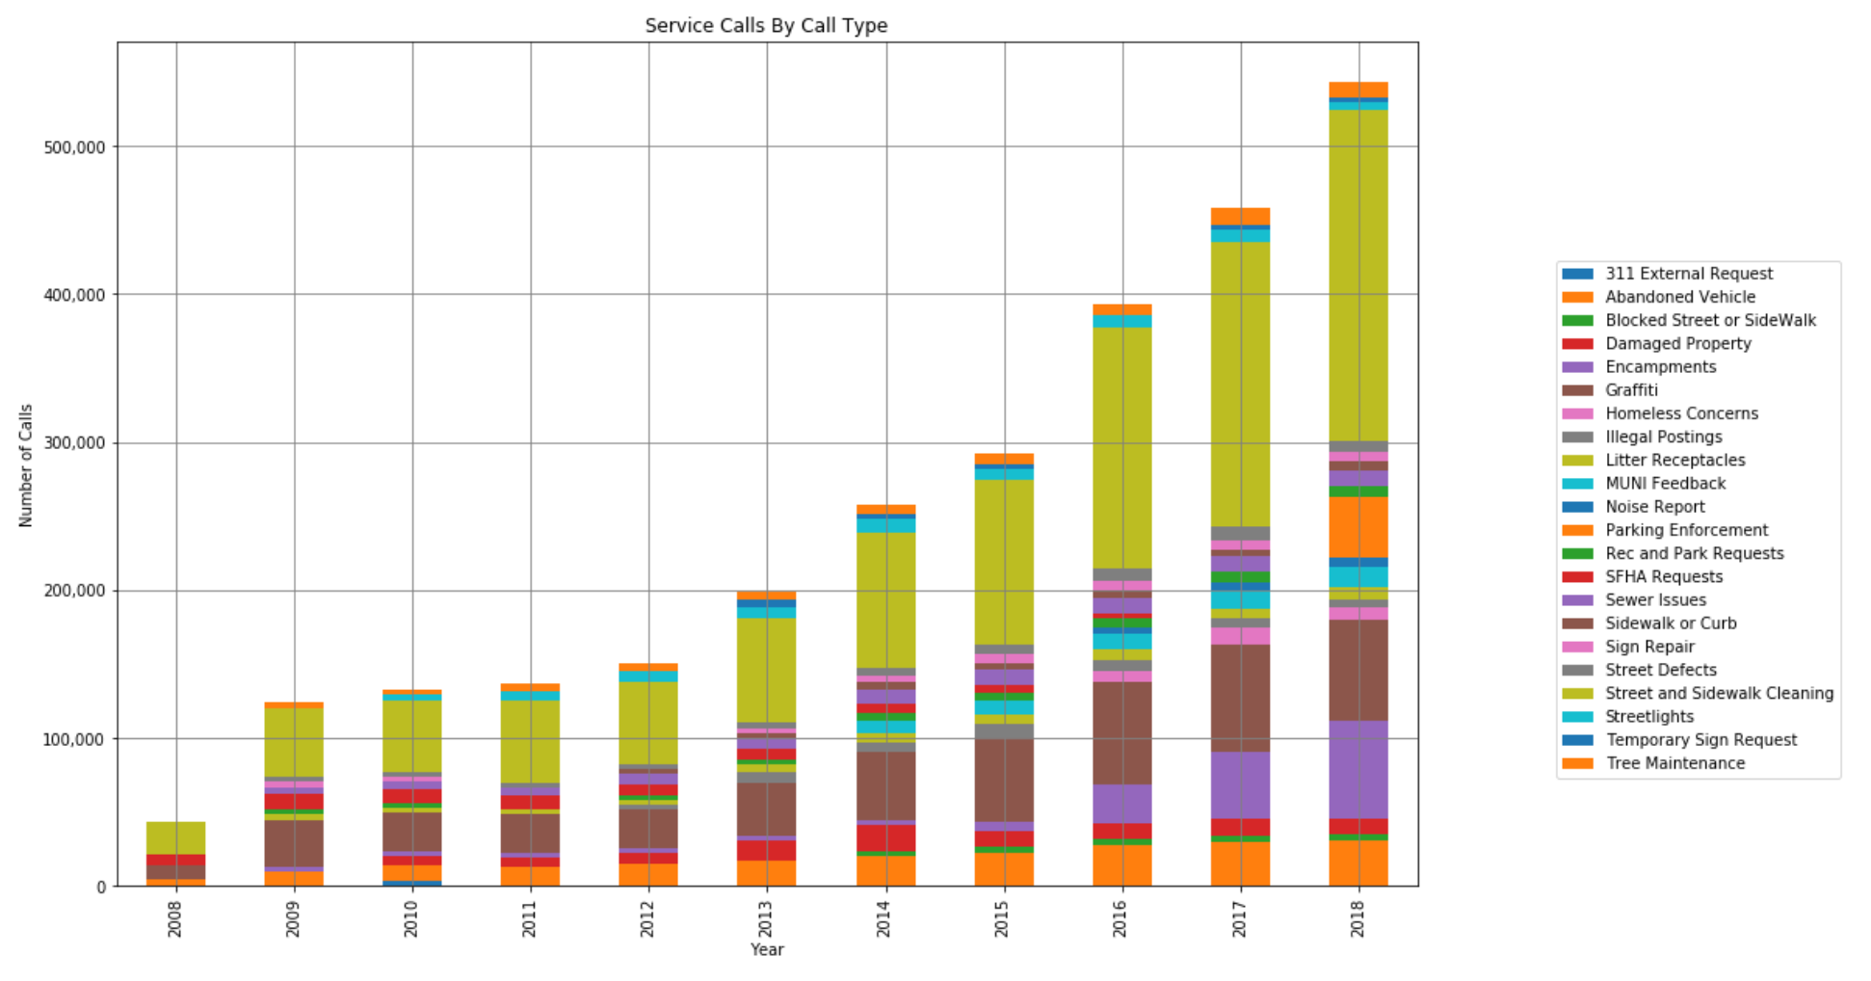
Citizen Complaints by Category

Slide 25
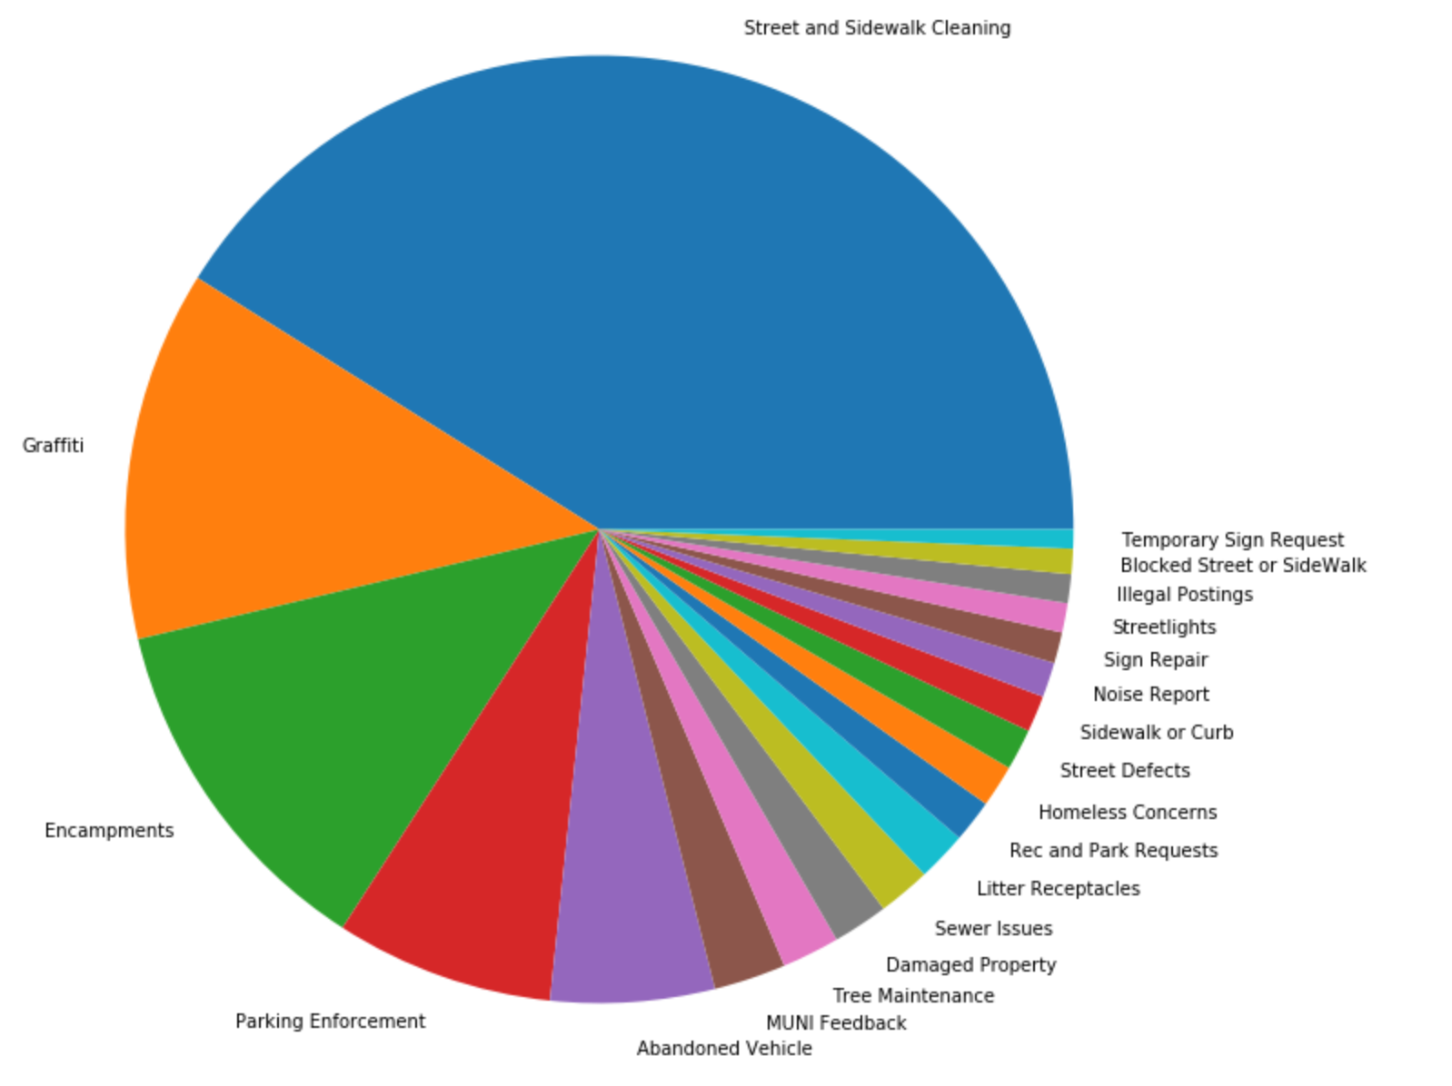
Citizen Complaints by Category (2018)

Slide 26
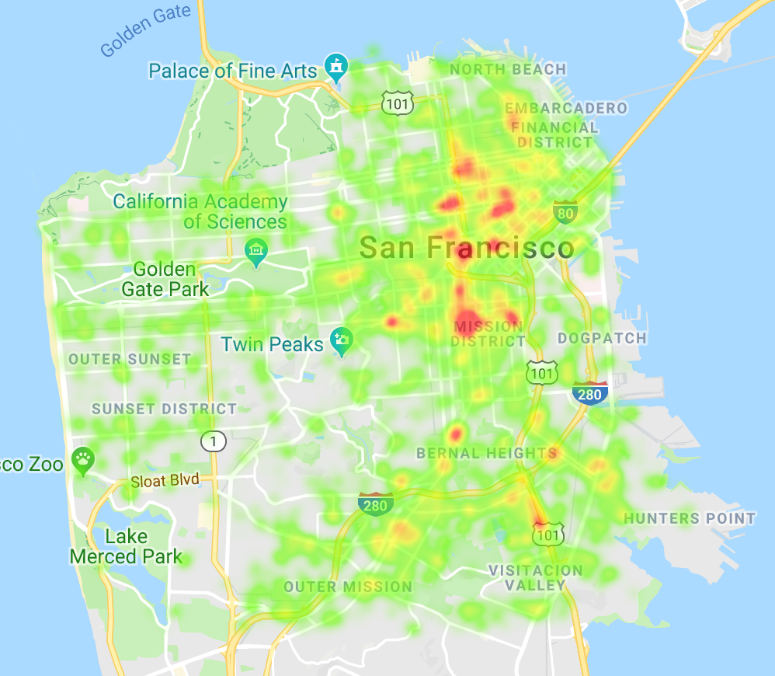
Heat Map: Location of 311 Calls (2018)

Slide 27
Citizen Complaints (311 Calls) By District
Overall, District 6 (SOMA) has the highest number of complaints per year.
District 6 also has the greatest increase in calls year after year. The number of calls in 2018 were 15.64 times greater than in 2008.
Overall, District 7 (West Portal) has the lowest number of complaints.
By far the largest share of complaints is for Street Cleaning.
Homeless Encampments and Graffiti are the second most type of service request as of 2014.

Slide 28
Fire Department Calls By District
Large data set (1.94 GB)
Removed duplicate Incident Numbers and converted a DateTime column into a Year column
Analyzed the Fire Department Call Data by District and Year
Looked at the different Call Type Groups by Year
The number of calls per year increased significantly in the 2012-2018 period

Slide 29
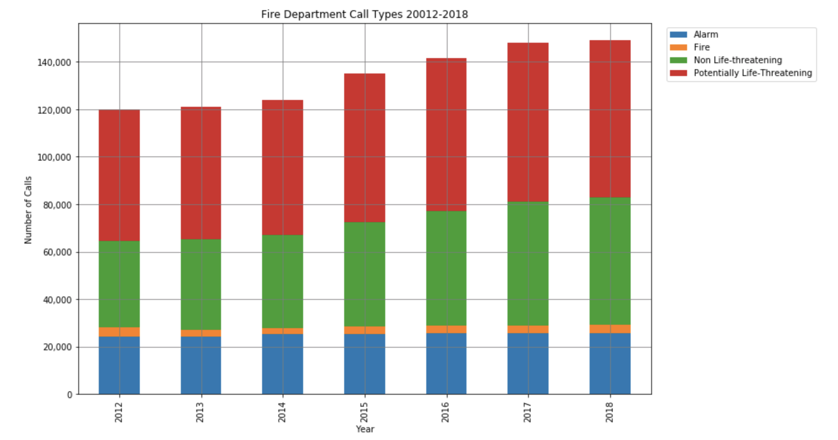
Fire Department Calls By Year

Slide 30
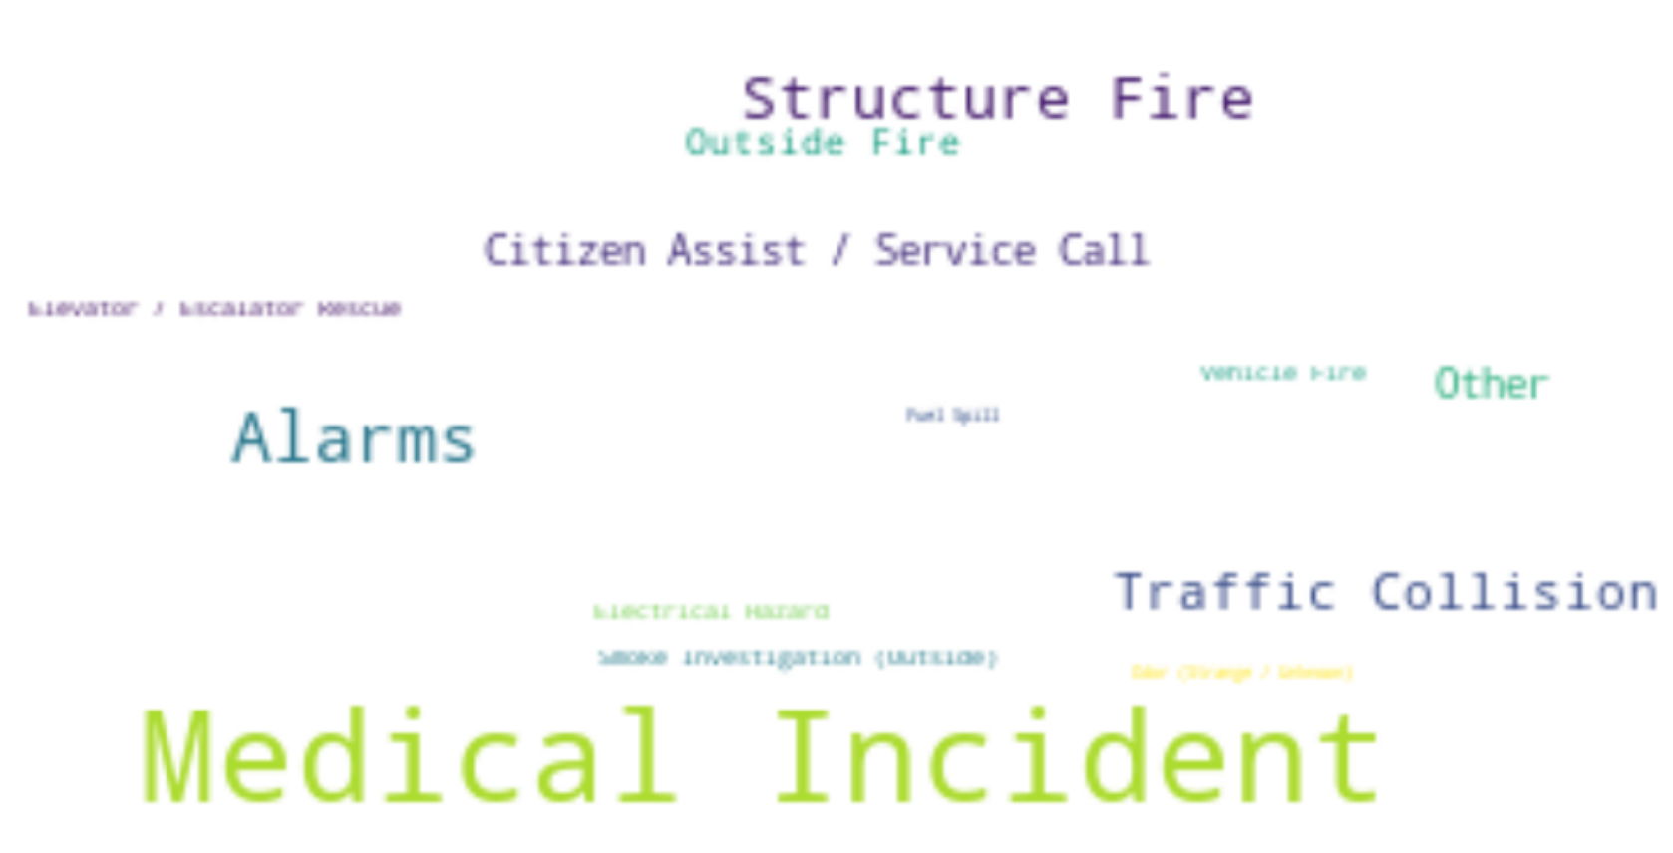
Fire Department Calls By Category

Slide 31
Fire Department Calls By District
Medical Incidents are the top reason for Fire Department calls.
Over time, fire department calls have been increasing in Non Life-Threatening and Potentially Life-Threatening categories.
Alarm and Fire calls have remained steady.
Most Fire Department calls are in Districts 3, 5, and 6 (North Beach, Haight, SOMA)

Slide 32
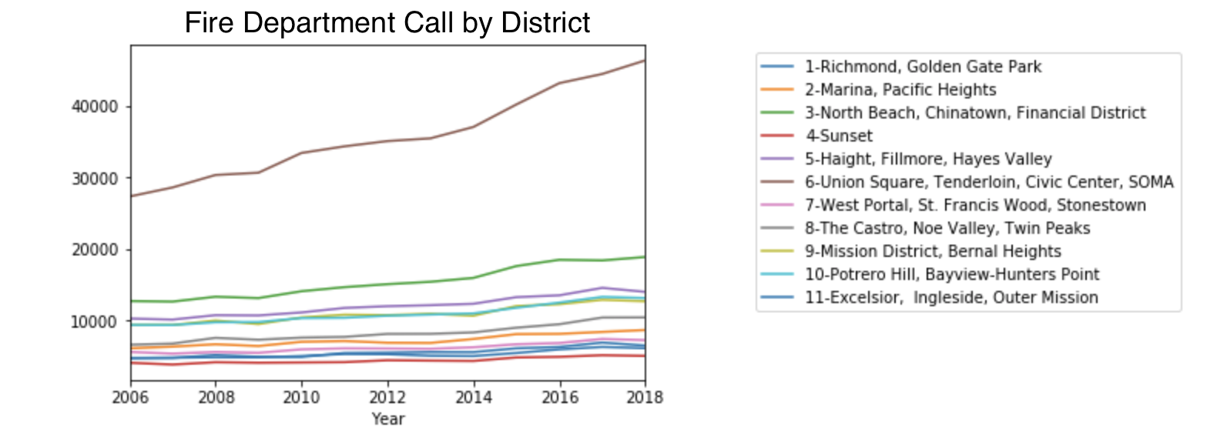
Fire Department Calls by District

Slide 33
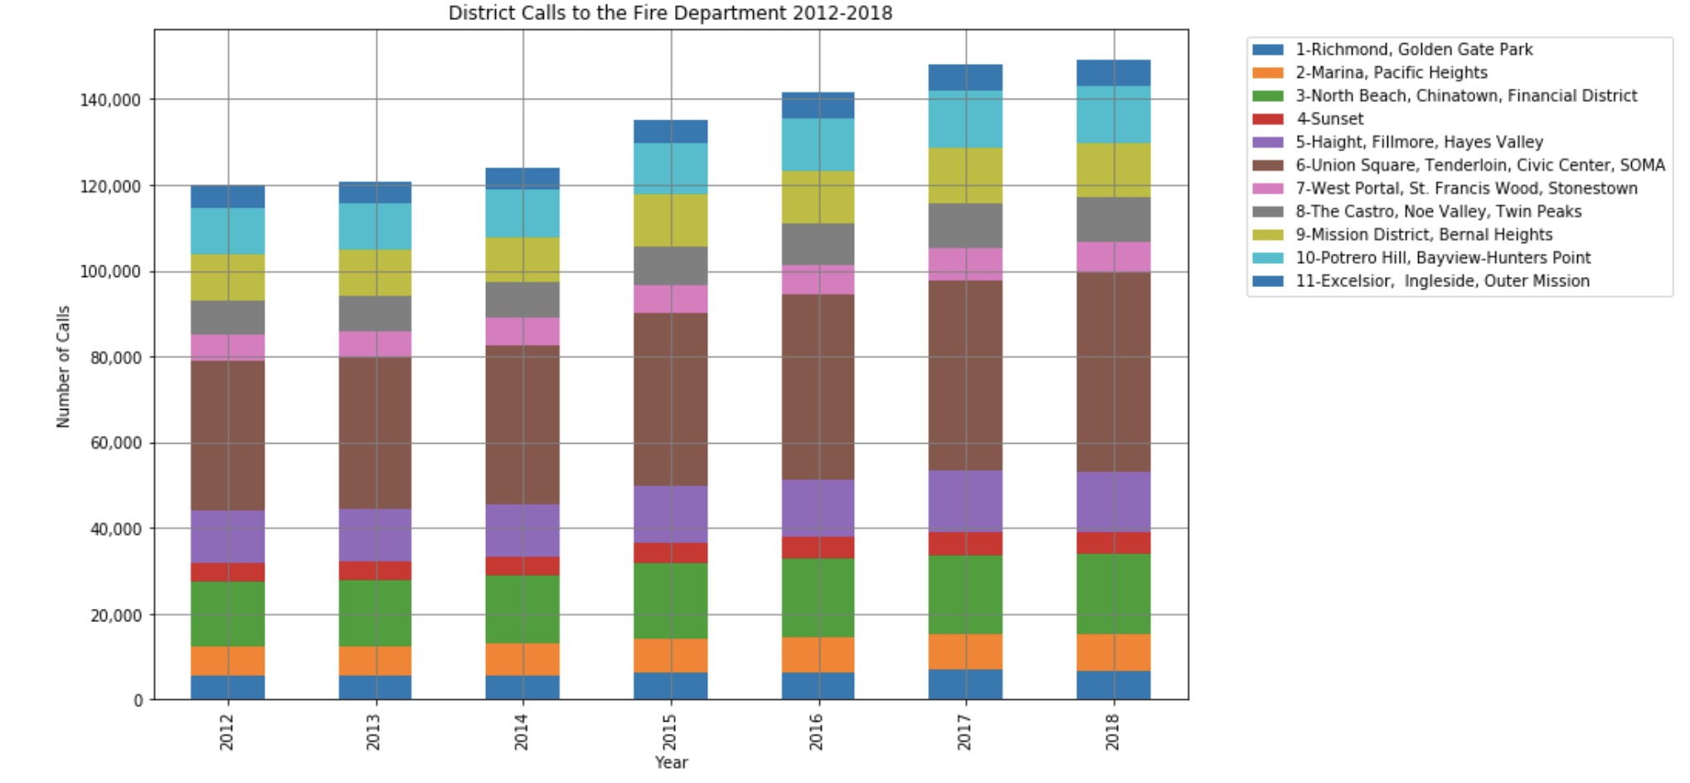
Fire Department Calls by District

Slide 34
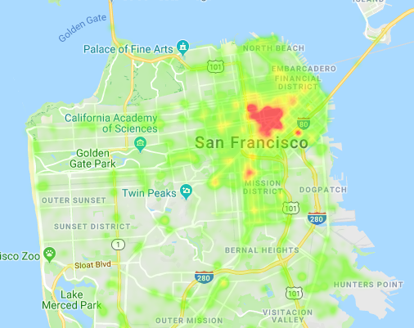
Heat Map: Location of Fire Calls (2018)

Slide 35
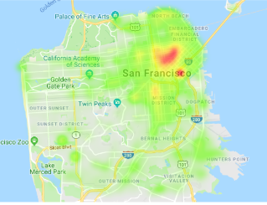
Heat Map: Activity Comparison (2018)
Police
Fire
311

Slide 36
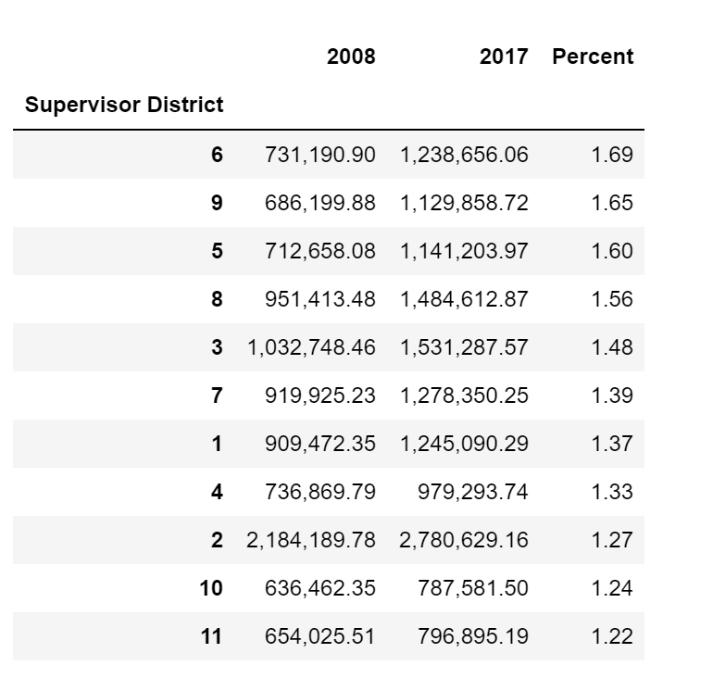
Historic House Price Increases

Slide 37
Conclusion
Other factors may affect the desirability of a neighborhood.
Districts 6 and 9 are neighborhoods in transition. High Police/Fire/311 activity does not seem to affect Property Values in these Districts. These areas are considered desirable.
Property values have been historically high in Districts 1 and 2. Police/Fire/311 activity is minimal in these neighborhoods.
Districts 10 and 11 have the lowest property values in the City. Police activity is significantly higher in these neighborhoods.
There may be a great disparity of experiences within a given District. However, using areas with equal number of residents provided a simple way to analyze the data.

Slide 38

Thank you for your time
If you want to buy a house, head to zillow.com/anonymouswalrus

